Slide 1
MAP REDUCE ALGORITHM USING JAVA FOR MATRIX MULTIPLICATION
GROUP - 6
Pradeep Reddy Malgari - 700741163
Anjani Priya Marthati - 700739769
Jahnavi Rao Metpally - 700740101
Bhargavi Sai Tanniru - 700748049
Rajesh Nalla - 700747145

Slide 2
MapReduce
MapReduce is a programming model or pattern within the Hadoop framework that is used to access big data stored in the Hadoop File System (HDFS).
MapReduce is an algorithm for processing large datasets in a distributed and parallel manner.
The main benefit of MapReduce is that users can scale data processing easily over several computing nodes.
The MapReduce algorithm involves two phases: Map and Reduce

Slide 3
Map and Reduce
Map phase: In the map phase, the input data is divided into chunks and distributed across multiple computing nodes. Each node applies a map function to its chunk of data to extract the relevant information and transform it into a set of key-value pairs.
Reduce phase: In the reduce phase, the intermediate results produced by the map phase are combined to produce the final output. The reduce function takes in the key-value pairs generated by the map phase and performs an operation on them to produce a smaller set of output values.

Slide 4
Matrix Multiplication
Hadoop MapReduce is a powerful tool for big data processing and can be used to solve a wide range of problems.
Matrix multiplication is an important operation in many fields, such as data science, machine learning, and scientific computing.
The matrix multiplication program is designed to handle sparse matrices efficiently, which can greatly reduce processing time and memory usage.
The program takes advantage of Hadoop's built-in features, such as input and output formats, to simplify the code and improve performance.
The matrix multiplication can be easily adapted to handle different matrix sizes and data formats and can be used as a starting point for more complex matrix operations.
By using Hadoop MapReduce for matrix multiplication, we can speed up computation time and process large datasets that would not be feasible on a single machine.

Slide 5
STEP FOR REDUCING MATRIX
(
)
(
)
5 8
3 4 4
3
7
4 1
=
(
)
9 * 1 + 5 * 6 + 8 * 4 9 * 3 + 5 * 7 + 8 * 1
3 * 1 + 4 * 6 + 4 * 4 3 * 3 + 4 * 7 + 4 * 1

Slide 6
MATRIX MULTIPLICATION:
(
)
(
)
3
7
4 1
5 8
3 4 4
=
(
)
9 * 1 + 5 * 6 + 8 * 4 9 * 3 + 5 * 7 + 8 * 1
3 * 1 + 4 * 6 + 4 * 4 3 * 3 + 4 * 7 + 4 * 1
To compute

Slide 7
INPUT AND OUTPUT INFORMATION
REDUCER
(
)
(
)
Inputs
5 8
3 4 4
3
7
4 1
output
=
(
)
9 * 1 + 5 * 6 + 8 * 4 9 * 3 + 5 * 7 + 8 * 1
3 * 1 + 4 * 6 + 4 * 4 3 * 3 + 4 * 7 + 4 * 1

Slide 8
INPUT AND OUTPUT INFORMATION
The function Reduce will calculate:
The dot product of a single row vector from matrix A.
A single column vector from matrix B.

Slide 9
Preprocessing for the map( ) function
The map() function only takes in one set of data at a time.
Input Stream for Map()
Map()
Reduce()
(a1,b1)
(a2,b2)
CPU 1
(a1,b1)(a1,b1’)
(a2,b2)(a2,b2’)
CPU 1
x1
x2
data
CPU 2
CPU 2
data
CPU 3
CPU 3
data
CPU 4
CPU 4
In Json (Key,Value) Format

Slide 10
THE INPUTS OF THE MATRIX MULTIPLICATION
Input Matrices
X
Y
X * Y
(
(
3
7
4 1
(
)
)
)
5 8
3 4 4
=
9 * 1 + 5 * 6 + 8 * 4 9 * 3 + 5 * 7 + 8 * 1
3 * 1 + 4 * 6 + 4 * 4 3 * 3 + 4 * 7 + 4 * 1
Inputs to “Matrix Multiplication”

Slide 11
Convert the input matrices to the form: (key1, value1) (key2, value2) (key3, value3)…
(
)
(
3
7
4 1
)
(
i1 j1
i2 j2
i3 j3
)
5 8
3 4 4
Inputs to “Matrix Multiplication”
Input to “Map Reduce”

Slide 12
PRE-PROCESSING USED FOR MATRIX MULTIPLICATION
i11
(
)
(X,1,1) 9
(X,1,2) 5
(X,1,3) 8
X
Y
i11
1 3
7
4 1
(
9 5 8
3 4 4
)
(
)
(
)
(Y,1,1) 1
(Y,1,2) 6
(Y,1,3) 4
i21

Slide 13
OVERVIEW
Map( ) input is as follows:
( (X, 1, 1) , i11 )
( (X, 1, 2) , i12 )
( (X, 1, 3) , i13 ) ...
( (Y, 1, 1) , j11 )
( (Y, 1, 2) , j12 )
( (Y, 1, 3) , j13 ) ...
Input for Reduce( ) :
1. The dot product of a single row vector from matrix A.
2. A single-column vector from matrix B.

Slide 14
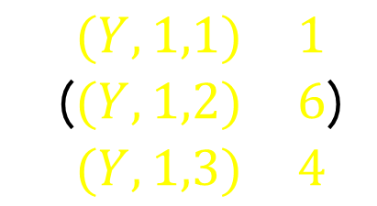
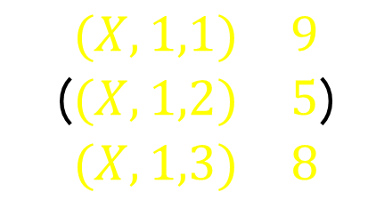
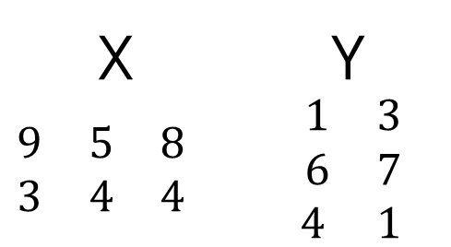
X Y $\begin{matrix}9 & 5 & 8 \\ 3 & 4 & 4\end{matrix}$ $\begin{matrix} 1 & 3 \\ 6 & 7 \\ 4 & 1 \end{matrix}$
(
)
(
)
Input data for 1 reducer :
1
6
4
9 5 8
Pre-Processing
Map()
Reduce()
($\begin{matrix}(X,1,1) & 9 \\ (X,1,2) & 5 \\ (X,1,3) & 8\end{matrix}$)
CPU 1
CPU 1
CPU 2
CPU 2
($\begin{matrix}(Y,1,1) & 1 \\ (Y,1,2) & 6 \\ (Y,1,3) & 4\end{matrix}$)
CPU 3
CPU 3
CPU 4
CPU 4
Shuffle (on first key)
Input data for Map Reduce

Slide 15
MAP FUNCTION ALGORITHM
Generate pairs of key-value in the form of ((i,k), (M,j,mij)) for every element mij in matrix M, where k is within the range of 1 to the number of columns present in matrix N.
Similarly, create pairs of key-value in the form of ((i,k), (N,j,njk)) for every element njk in matrix N, where i is within the range of 1 to the number of rows present in matrix M.
Finally, return a set of key-value pairs where each key (i,k) contains a list of values (M,j,mij) and (N,j,njk) for all possible values of j.

Slide 16
ALGORITHM FOR REDUCE FUNCTION
To process each key (i,k), execute the following steps:
Sort the values that begin with M by j and store them in a list named listM.
Sort the values that begin with N by j and store them in a list named listN.
For each value of j in both listM and listN, multiply the corresponding mij and njk values.
Sum all the obtained products of mij and njk for every j value.
Output the key (i,k) and the sum of Σj=1 mij x njk as the result.

Slide 17
CONCLUSION
The MapReduce framework can be used to perform matrix multiplication in a distributed computing environment, allowing for faster processing of large-scale data sets.
By dividing the computation across multiple nodes, MapReduce can provide significant speedups and improved scalability for matrix multiplication and other data processing tasks.

